Slide 1
MULTI REQUEST ROUTE PLANNING USING ONE WAY SEARCH
Dasari Charan Srinivas Reddy -242IT007
Konduru Sai Kiran -242IT014
Kunduru Phaneendra Reddy -242IT016
Nandam Sai Saketh -242IT021

Slide 2
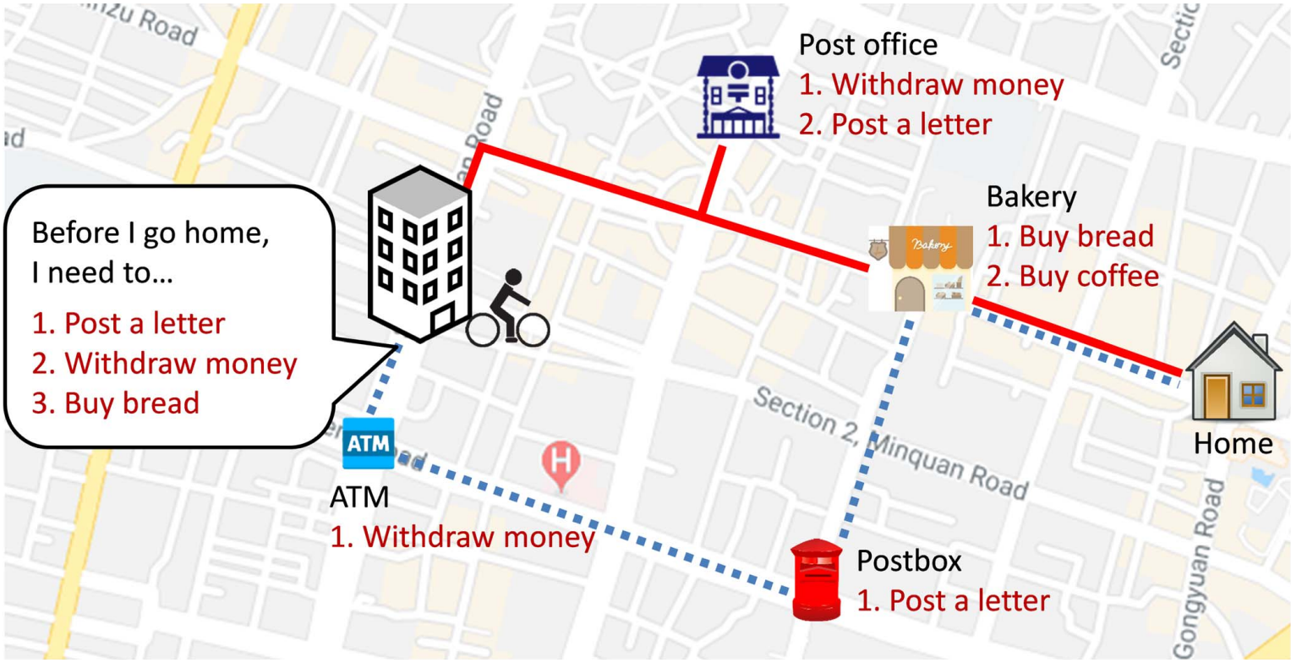
INTRODUCTION
In LBSs, a point-of-interest (POI) is a basic element that marksa map with points that people may be interested in, such asrestaurants, gas stations, and hospitals.
Google Maps, Bing Maps, and OpenStreetMap, provide POIquery and route planning services
The goal of MRRP is to plan the shortest route that meets the requests specified by the user.
Users of MRRP queries mainly value shorter routes and faster response times for optimal results.

Slide 3
PROBLEM STATEMENT
Given a set of user and service requests each specifying a desired destination, find the optimal route that efficiently serves all requests while minimizing travel distance or time.
OBJECTIVES
Develop an efficient algorithm for route planning with multiple requests that can handle various types of requests and optimization criteria.
Improve the quality of route plans by finding optimal or near-optimal solutions that minimize travel distance or time while satisfying all user requests.
Evaluate the performance of the proposed algorithm and compare it with existing methods to demonstrate its effectiveness.

Slide 4
METHODOLOGY
OWS first searches a route on the basis of the POIs that provide at least one unsolved user request and pass three pruning mechanisms.
One of them is greedily selected for path expansion and route update to rapidly identify a more favorable route.
OWS involves three pruning mechanisms named Filter, Potential, and Petrifaction mechanisms and three operations named Wilting, Selection, and Reverse Update to avoid unnecessary searches and thus improve search efficiency.

Slide 5
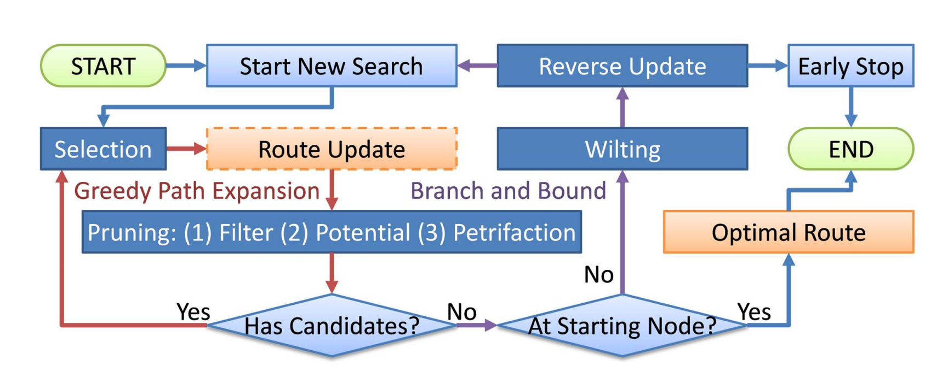
FLOW CHART

Slide 6
BASE PAPER
Paper title: One-Way Search Algorithm for Route Planning With Multiple Requests. https://ieeexplore.ieee.org/stamp/stamp.jsp?tp=&arnumber=9946862
Publisher: IEEE TRANSACTIONS ON INTELLIGENT TRANSPORTATION SYSTEMS,VOL. 24, NO. 2, FEBRUARY 2023

Slide 7
THANK YOU

